Slide 1

Introduction to algorithms nonlinear Data structures - trees
Lecture 7
Thursday, 11 November 2021

Slide 2









Recap of last lecture
best-case
complexity
average
complexity
worst-case
complexity
Sort algorithm
Insertion sort
$$O(n)$$
$$O(n^{2})$$
$$O(n^{2})$$
Merge sort
$$O(n\log{n})$$
$$O(n\log{n})$$
$$O(n\log{n})$$
fastest algorithm
Quick sort
$$O(n\log{n})$$
$$O(n\log{n})$$
$$O(n^{2})$$

Slide 3
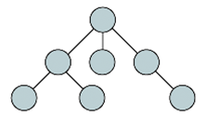

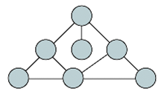
Types of data structures
A data structure is a conceptual tool for storing, sorting and manipulating various forms of data
LINEAR
NONLINEAR
lists/arrays
trees
linked lists
graphs

Slide 4
trees
Trees are data-structures, similar to lists.
A tree consists of:
a finite set of elements, called nodes;
Nodes are linked via branches

Slide 5
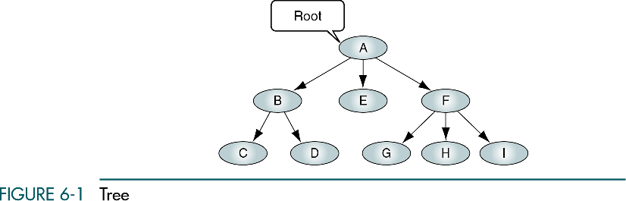
trees
A tree is a set of nodes that are either empty or hold a value
Root of a tree: a principal node from which all other nodes and branches develop
Subtrees: are smaller trees that descend from root or other lowers nodes
root
branch
This tree has 9 nodes
subtree

Slide 6
Children and degree of a node
The nodes developed from any node are called children of that node.
Children of A:
Children of B:
Children of E:
Children of F:
B, E, F
C, D
NONE!
G, H, I
Degree of a node: the number of children of each node
Degree of A:
Degree of B:
Degree of E:
Degree of F:
Degree of C:
Degree of H:
3
2
0
3
0
0

Slide 7
height of a tree (similar to the length of a list!!)
Level 0 (generation 0)
height = 3
Level 1 (generation 1)
Level 2 (generation 2)
The height of a tree is the number of generations (levels)
beginning from the root of the tree, going downwards

Slide 8
Size of a tree (number of nodes)
The size of a tree is the total number of its nodes
A
B
E
C
D
F
size=9
size=6

Slide 9
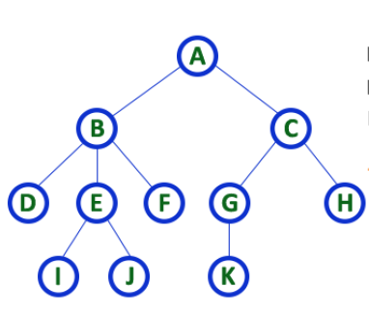
Binary trees
A binary tree is a tree in which: each node has at most two children
A
A
B
E
B
E
C
D
F
C
D
F
G
G
General Tree
Balanced Binary Tree
Binary Tree

Slide 10
Binary trees
A binary tree is a tree in which: each node has at most two children
A
A
B
A
B
E
C
B
E
C
D
F
D
C
D
F
G
G
Binary Tree
Binary Tree
not different from a list
Balanced Binary Tree

Slide 11
Pseudocode for building binary trees
nil
make an empty list
[ ]
leaf
make an empty tree
a node with no value
cons(x,list)
node( ,x, )
X
leaf
leaf
makes a node with value X
node(left ,root, right)

Slide 12
examples
node(node(leaf,50,leaf),10,node(leaf,40,leaf))
node(leaf,5,leaf)
5
Left
Right
10
50
40
node(node(leaf,5,leaf),7,leaf)
7
5
Left
Right

Slide 13
example
A
B
E
C
G
node( , A, )
node( ,B, leaf)
node(leaf,E, )
node(leaf,C,leaf)
node(leaf,G,leaf)

Slide 14
Binary Tree manipulation
There are four functions for manipulating binary trees:
isLeaf
determines if a tree is a leaf or not (Boolean);
left
returns the left subtree of a tree;
root
returns the value stored in the root;
right
returns the right subtree of a tree.
[isEmpty]
[tail]
[head]
[tail]

Slide 15
example
(T):
root(T)=
A
E
(right(T))=
A
F
B
left(T)=
B
E
G
C
D
F
C
D
F
right(right(T))=
root(left(T))=
B
G
G
root(root(left(T)))=
Not valid!
left(root(left(T)))=
Not Valid
root(right(T))=
E

Slide 16
Binary trees of numbers
We will work with
binary trees whose
node values are numbers.

Slide 17
Accessing nodes of a binary tree
Remember how we accessed elements of a list
L=[0,2,4,6,7,8,9,12,20]
tail(tail(tail(tail(L))))

Slide 18
Accessing nodes of a binary tree
Remember how we accessed elements of a list
L=[0,2,4,6,7,8,9,12,20]
head(tail(tail(tail(tail(L)))))=7
7
left(right(tree))
4
9
2
6
8
12

Slide 19
Accessing nodes of a binary tree
Remember how we accessed elements of a list
L=[0,2,4,6,7,8,9,12,20]
head(tail(tail(tail(tail(L)))))=7
7
root(left(right(tree)))=8
4
9
Use left and right to walk down a binary tree
2
6
8
12

Slide 20
Think about …
How would you
count the number
of nodes in
binary trees?
How would you
count the number
of generations in
binary trees?
SIZE
HEIGHT

